Slide 1
Caring Pharmacy
Business Process Management
Group R

Slide 2
01
02
03
04
COMPANY PRESENTATION
BUSINESS PROCESS AND AS-IS MODELS
PROCESS ANALYSIS
PROCESS REDESIGN AND TO-BE MODELS
04
05
IMPLEMENTATION PLAN

Slide 3
1
Company
Caring Pharmacy

Slide 4



Caring Pharmacy
Caring Lisbon Pharmacy
Portuguese pharmacy in business since 1998
Open from 10 am to 6 pm
220 customers per day
7 employees – 4 technicians and 3 pharmacists
Stores located in 8 different Portuguese cities
Business Problem
More than 80 employees, from pharmacists to technicians.
Business process inefficient and slow
Inability to serve every customer during opening hours
Costumers' dissatisfaction

Slide 5
2
Business Process
Order-to-cash

Slide 6
Order-to-cash
01
02
Enter and Check Prescription
Receive Client
03
04
Deliver and Payment
Fulfill Order

Slide 7
3
AS-IS Models

Slide 8
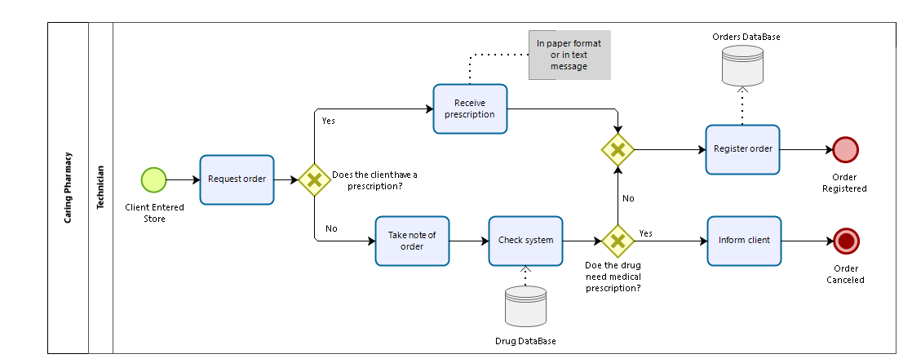
Receive Client

Slide 9
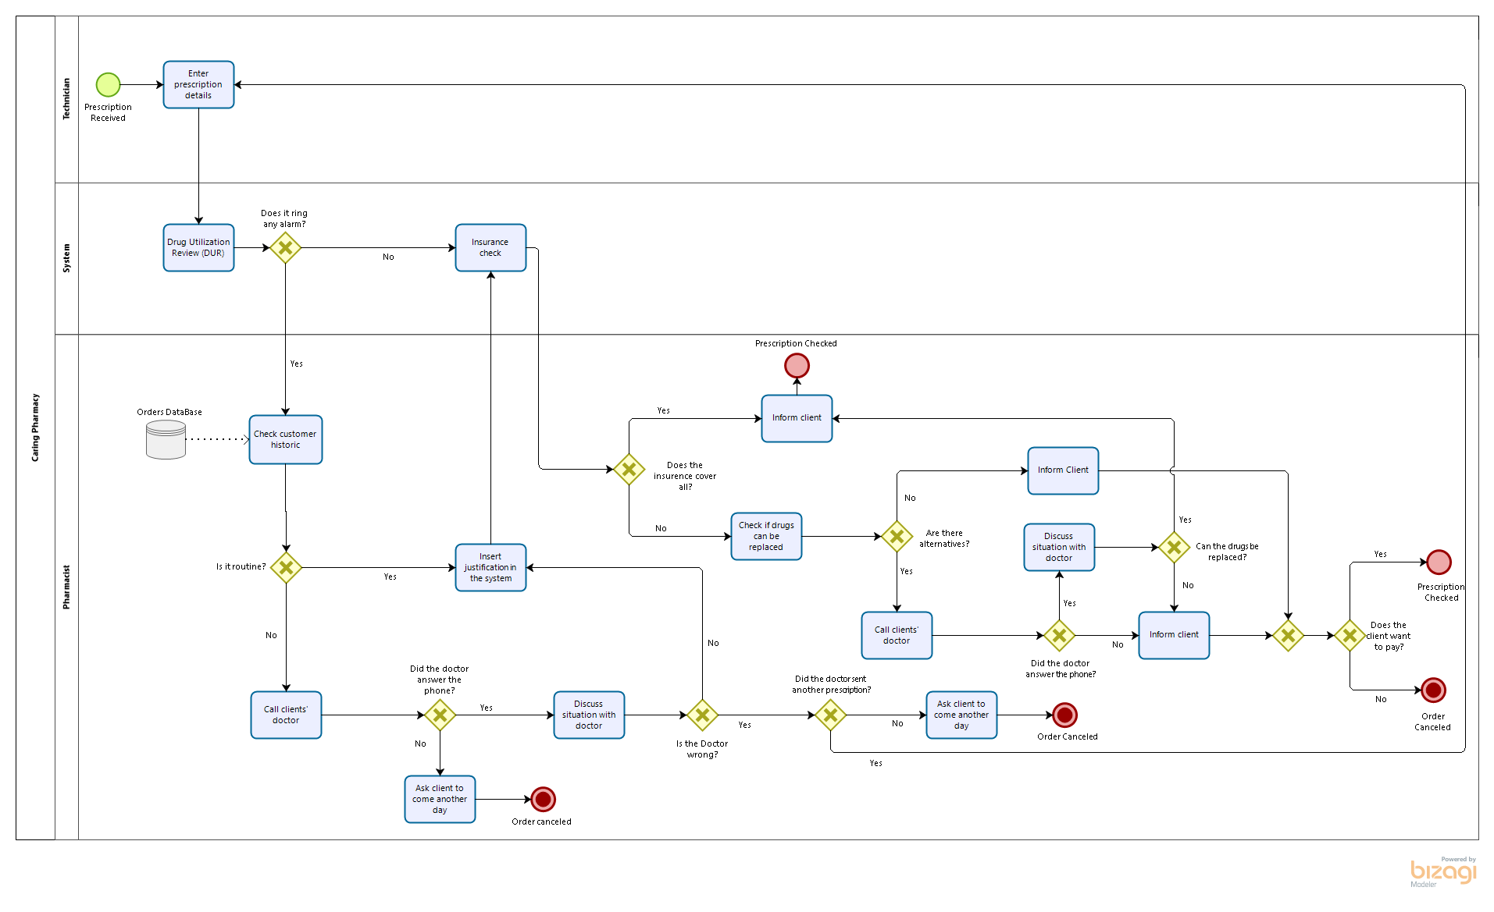
Enter and Check Prescription

Slide 10
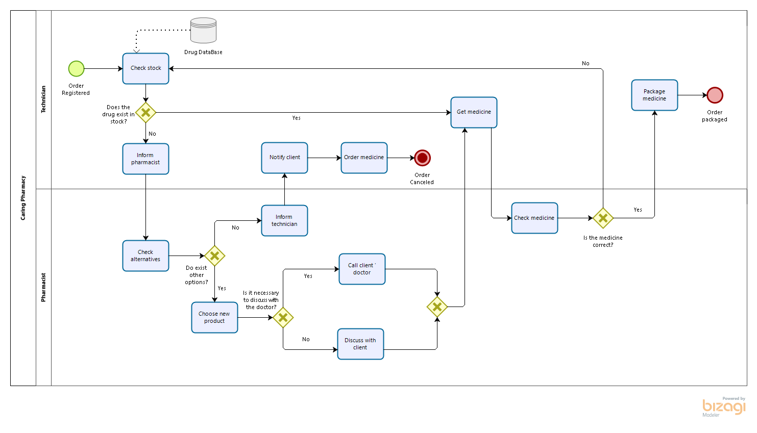
Fulfill Order

Slide 11
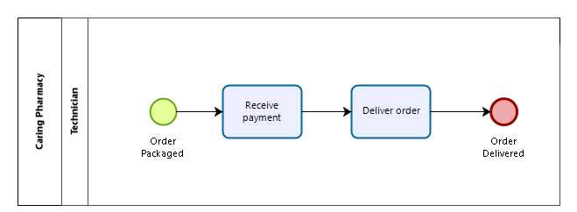
Deliver and Payment

Slide 12
4
Qualitative Analysis

Slide 13
Qualitative Analysis
01
02
03
Value-Added Analysis
Waste Analysis
Issue Register Analysis

Slide 14
Value-Added Analysis
Enter and Check Prescription

Slide 15
Waste Analysis
Enter and Check Prescription

Slide 16
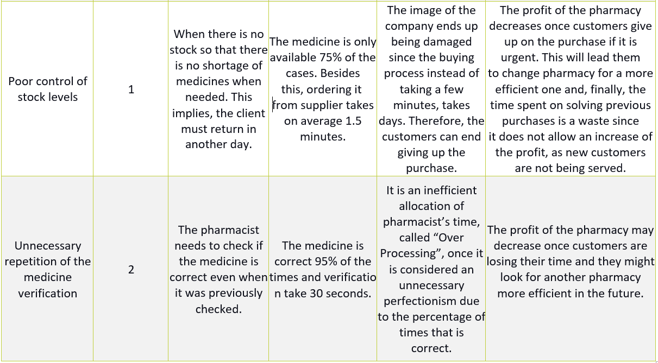
Issue Register Analysis

Slide 17
5
Quantitative Analysis

Slide 18


Quantitative Analysis
01
Focus on the process performance measure time
Simulation
02
Goal: improve cycle time efficiency
What-If Analysis

Slide 19
Simulation
1. Process Validation
2. Time Analysis
Ensured everything was synchronized.
Defined the probabilities for the gateway.
Defined the number maximum of arrivals (220).
Start Event: Poisson Distribution
All Activities: Truncated Normal Distribution
Mean Arrival rate (λ)= Total Arrivals per Day / Total
Time of the Workday (in min) = 220/480= 0,4583(3)
Mean Inter-Arrival Time= 1/ λ= 1/0,4583= 2,182
Every 2 minutes and 22 seconds a new client enters the pharmacy.
3. Resource Analysis
This process for each client, involves 1 technician, 1 pharmacist, and 1 system.

Slide 20
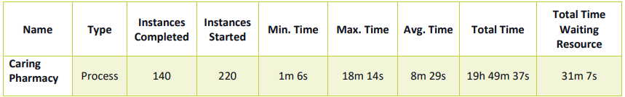
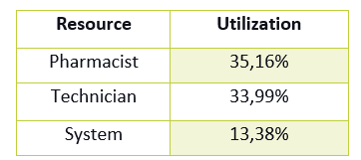
Simulation Results
The average time is 8 minutes and 29 seconds.
Only 140 out of 220 orders are completed.
The activity that takes the longest in the company’s process is “Call clients’ doctor” with around 4 minutes.
The resource utilization is very low.

Slide 21
What-If Analysis
Six different scenarios were tested:
3 technicians and 2 pharmacists
4 technicians and 1 pharmacist
2 technicians and 4 pharmacists
2 technicians and 3 pharmacists
2 technicians and 2 pharmacists
3 technicians and 3 pharmacists

Slide 22
6
Process Redesign
TO-BE Models

Slide 23
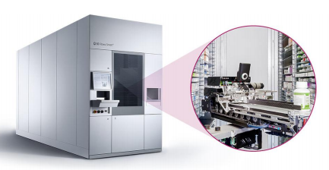
Process Redesign
Transactional Process Redesign Approach
Sifarma
Information System from Glintt
Pharmacy Management Software
Rowa Vsmart
This robot prices start at 54 999€.

Slide 24
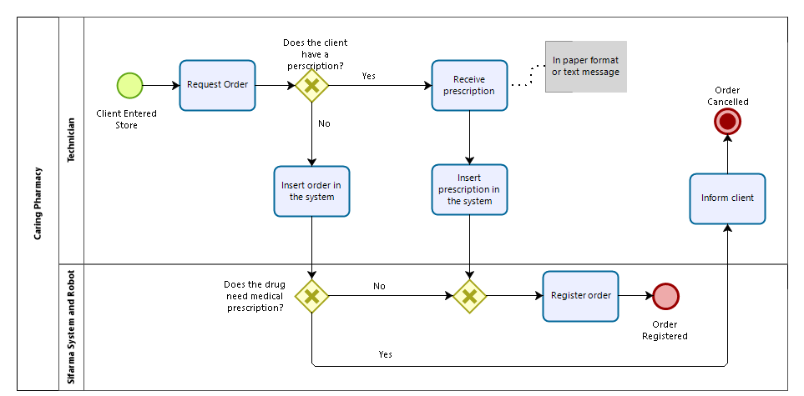
Receive Client

Slide 25
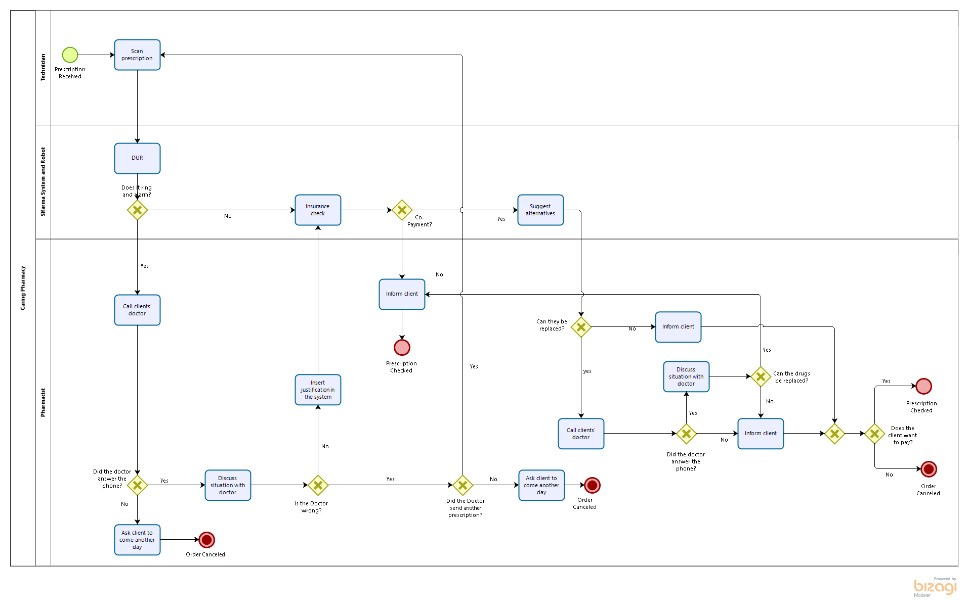
Enter and Check Prescription

Slide 26
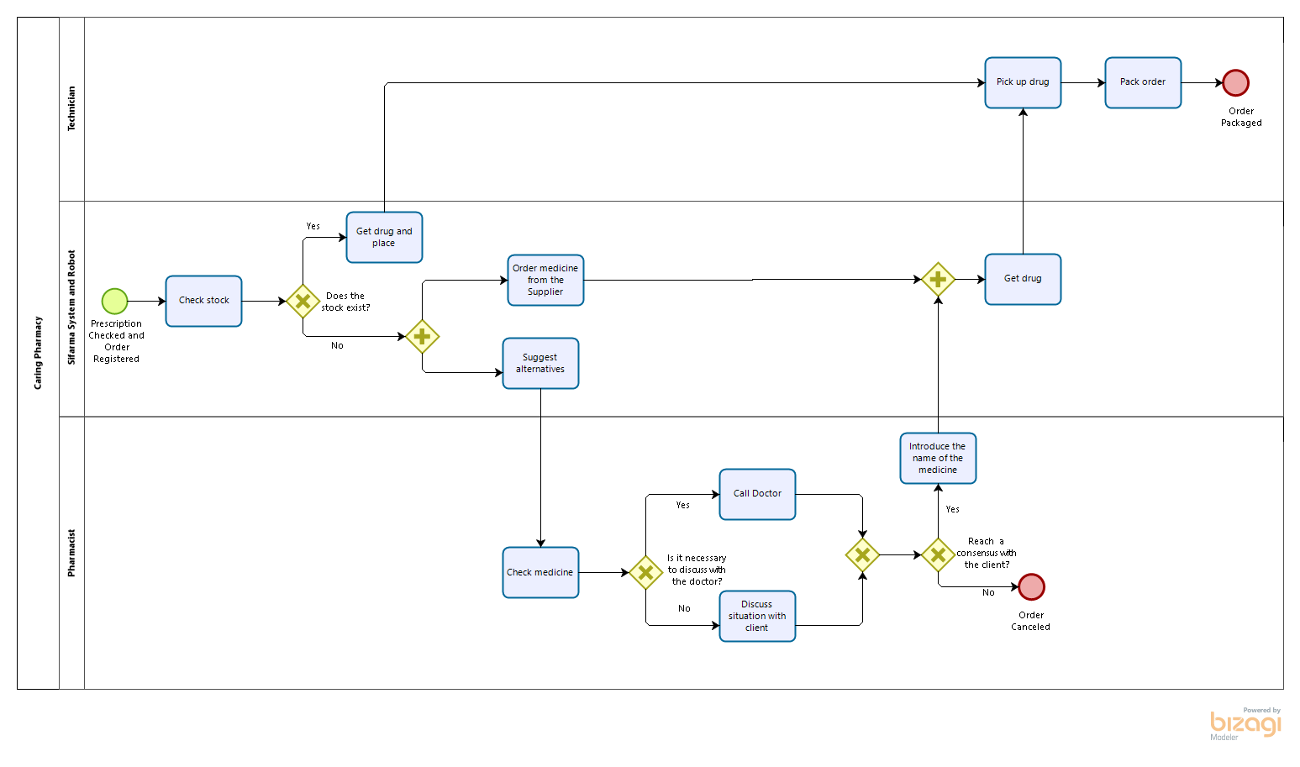
Fulfill Order

Slide 27
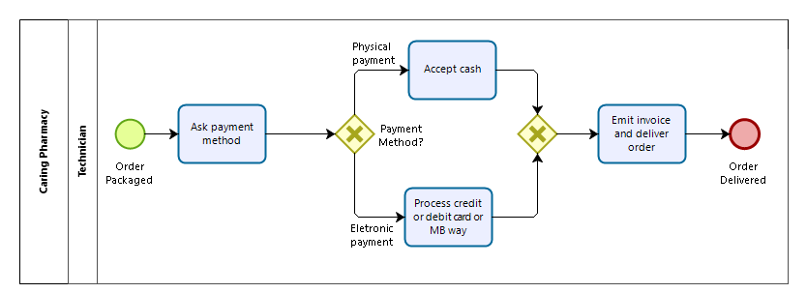
Deliver and Payment

Slide 28
8
Implementation Plan

Slide 29
Implementation Plan
To perform at its fullest some adjustments need to be made:
Confirm the most important steps of the order in different stages to avoid errors and mistakes.
Full integration of the system in the robot.
Employee training to ensure that the employees take full advantage of the system and robot.
Make sure that the system and robot are kept updated.
To better manage the queue, we recommend a ticket queue management system

Slide 30
Thanks!
Do you have any questions?
Please keep this slide for attribution

